Slide 1
Linux

Slide 2
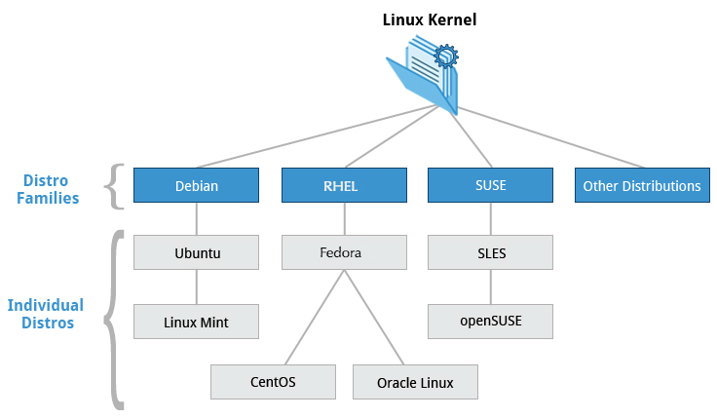
Linux Distributions
Distribution: Collection of software making up a Linux-based distribution all licensed under open-source or GPL
Source: Linux foundation

Slide 3
Linux Distributions
Technical differences between distributions are mainly about package management systems, software versions, and file locations.
Once you get a grasp of those differences, it becomes relatively painless to switch from one Linux distribution to another.
Source: Linux foundation

Slide 4
Questions to Ask When Choosing a Distribution
What is the main function of the system (server or desktop)?
What types of packages are important to the organization? For example, web server, word processing, etc.
How much hard disk space is required and how much is available? For example, when installing Linux on an embedded device, space is usually constrained.
How often are packages updated?
How long is the support cycle for each release? For example, LTS releases have long-term support.
Do you need kernel customization from the vendor or a third party?
Do you need long-term stability? Can you accept (or need) a more volatile cutting edge system running the latest software?
Source: Linux foundation

Slide 5
Why Linux
Is everywhere
Open source
Community support
Basics of DevOps
90% of all cloud infrastructure is powered by linux

Slide 6
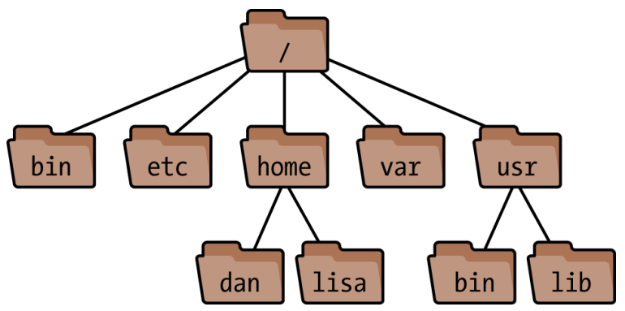
Linux File System Hierarchy Standard
Notes:
For more information, take a look at the following document: "Filesystem Hierarchy Standard" created by LSB Workgroup.
https://refspecs.linuxfoundation.org/FHS_3.0/fhs-3.0.pdf

Slide 7
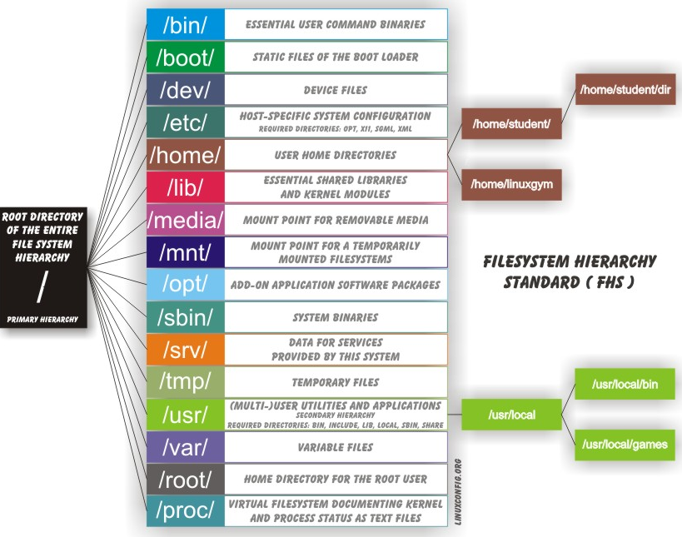
Linux File System Hierarchy Standard
Source: Linux foundation
Notes:
For more information, take a look at the following document: "Filesystem Hierarchy Standard" created by LSB Workgroup.
https://refspecs.linuxfoundation.org/FHS_3.0/fhs-3.0.pdf

Slide 8
Linux Disto. Packages & Managers
Most common types of packages are
.deb files
Debian packages, used by Debian, Ubuntu, and other distros.
Installed by the aptitude, apt-get, and dpkg package manager commands
.rpm files
RPM Packages are used by Red Hat, Fedora,CentOS, and other distros.
Installed by the dnf, yum, and rpm package manager commands

Slide 9
Linux Disto. Packages & Managers – Examples
Debian package manager
Update the package index.
Installed by the aptitude, apt-get, and dpkg package manager commands
For more details, please follow the apt documentation and a short tutorial
apt update | Update the package index. This index is a local database of available repositories. See /etc/apt/sources.list etc.
apt upgrade | Upgrade version of packages
apt install pkg_name | Installing package
apt remove pkg_name | Removing pakcage
apt search pkg_name | Searching for a particular package
apt show pkg_name | Show the detail of the package
apt list | List all the packages that can be installed, try using --installed option

Slide 10
Command Line Interface
You can implement scripts for often-used (or easy-to-forget) tasks and series of procedures.
You can sign into remote machines anywhere on the Internet.
You can initiate graphical applications directly from the command line instead of hunting through menus.
While graphical tools may vary among Linux distributions, the command line interface does not.

Slide 11
Some Basic Utilities

Slide 12
Command?
Command typically consists of a program name followed by options and arguments
wc -l devops_course_outline.txt
Command counts the number of lines in a file
wc | program to execute
-l | is a option that changes behavior of the program. Usually starts with one or two dashes (i.e. -, --)
devops_course_outline.txt | argument for the program to operate on

Slide 13
For Kernel and OS version
uname -a
lsb_release -a
cat /etc/os-release

Slide 14
Sudo Command?
sudo is a special user with the ability to do anything, generally root (known as superuser)
sudo ls –la /root
Listing file and directory permissions with -l option and a for listing hidden files

Slide 15
Basic Operations → Logging in to Remote System
Secure SHell (SSH) allows you to connect and log into remote systems using either a password (as with regular logins) or public/private keys to verify the identity.
ssh username@remoteserver.com
ssh encrypts all the communication between client and server machines
Note: Server must have sshd installed and running in order to accept ssh connection

Slide 16
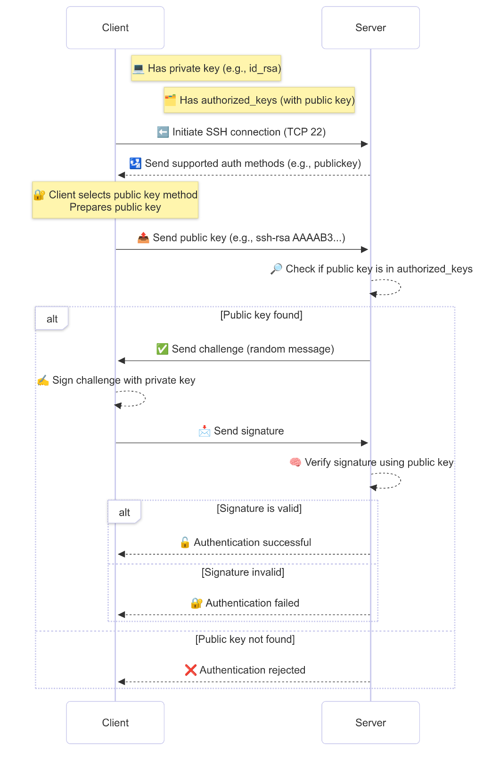
Logging in to Remote System

Slide 17
Basic Operations → Generating Keys
ssh-keygen
Will create public and private keys under ~/.ssh/
~/.ssh/id_rsa
~/.ssh/id_rsa.pub
Notes:
ssh-add ~/.ssh/private_key
Disable root password login - sudo nano /etc/ssh/sshd_config
PermitRootLogin no
PasswordAuthentication no
Reload sshd service - sudo systemctl reload sshd
eval `ssh-agent -s`

Slide 18
Basic Operations → Locating Applications
Following utilities are helpful for locating the applications
which diff
/usr/bin/diff
whereis diff

Slide 19
Basic Operations → Accessing Directories
pwd diff
Displays current directory
cd or cd ~
Change to your home directory
cd ..
Change to parent directory
cd –
Change to previous directory

Slide 20
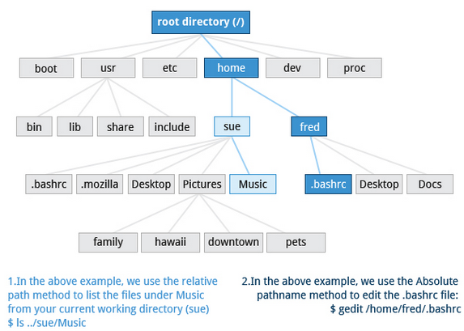
Basic Operations → Absolute & Relative Paths
Absolute
An absolute pathname always start with / (root directory).
Relative
A relative pathname starts from the present working directory. Relative paths never start with /.
cd /usr/bin
Absolute path
cd ../usr/bin
Relative path

Slide 21
Basic Operations → Exploring Filesystem
Tree command
The tree command is a good way to get a bird’s-eye view of the filesystem tree
The following commands can help in exploring the filesystem:
cd / | Changes your current directory to the root (/) directory (or path you supply)
ls | List the contents of the present working directory
ls -la | List all files, including hidden files and directories (those whose name start with . )
tree | Displays a tree view of the filesystem

Slide 22
Viewing Files
You can use the following commands to view files in command line
wc | Counts words in a file
cat | Used for viewing files that are not very long; it does not provide any scroll-back. –n option to show the line numbers
tac | Used to look at a file backwards, starting with the last line.
less | Used to view larger files because it is a paging program. It pauses at each screen full of text, provides scroll-back capabilities, and lets you search and navigate within the file.
tail | Used to print the last 10 lines of a file by default. You can change the number of lines by doing -n 15 or just -15 if you wanted to look at the last 15 lines instead of the default.
head | The opposite of tail; by default, it prints the first 10 lines of a file.

Slide 23
Viewing Files – touch command
touch is often used to set or update the access, change, and modify times of files.
Also used to create empty files
touch devops_class
Create new empty file
touch -t 12091600 devops_class
This sets the devops_class file's timestamp to 4 p.m., December 9th (12 09 1600)

Slide 24
Searching for Files – locate command
The locate utilizes a database created by a related utility, updatedb.
It match all entries that contain a specified character string in a constructed database of files and directories on your system.
Most Linux systems run this automatically once a day
locate zip
Will list all folders and files contain zip

Slide 25
Searching for Files – find command
find is an extremely useful and often-used utility program in the daily life of a DevOps Eng.
Think
Automate file operations (cleanups, backups)
About deleting old files of certain types (backups)?
Search logs or config files across systems
Changing permission of certain type of files etc.
Identify large files eating disk space
Powerful when used in CI/CD scripts

Slide 26
Searching for Files – find command
Basic syntax
find [path] [expression]
find /var/log -name “*.log”
Searching for files ending with .log
find /usr -name gcc
Searching for files and directories named gcc
find /usr -type d -name gcc
Searching only for directories named gcc
find /usr -type f -name gcc
Searching only for regular files named gcc

Slide 27
find command - Commonly Used Options
-name Match filename (case-sensitive)
-iname Match filename (case-insensitive)
-type File type (f=file, d=dir)
-size File size (+100M, -10k)
-mtime Modified time (in days)
-exec Execute command on result
-user Files owned by user

Slide 28
Searching for Files – find command – More options
find -name “*.jpg” –exec rm {} ‘;’
Find and remove all files that end with .jpg in current directory and its subdirectories.
find / -ctime 3
find files based on time.
find / -size 0
find files based on sizes.
find / -size +10M -exec command {} ’;’
find files greater than 10 MB in size and running a command on those files.
The {} is a placeholder that will be filled with all the file names that result from the find expression, and the preceding command will be run on each one individually.

Slide 29
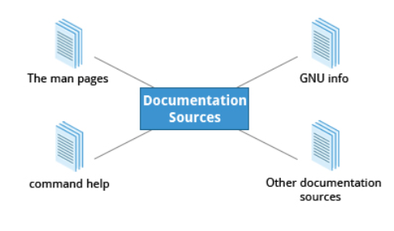
Linux Documentation Sources

Slide 30
Linux Documentation – The Man Pages
The man pages are the most often-used source of Linux documentation.
Typing man with a topic name as an argument retrieves the information stored in the topic's man pages.
man apache2
man –k compress

Slide 31
Linux Documentation – The GNU Info
This is the GNU project's standard documentation format, which it prefers as an alternative to man.
Information can be viewed through either a command line interface, a graphical help utility, printed or viewed online.
info <topic name>
info make

Slide 32
Linux Documentation – The --help Option
Most commands have an available short description which can be viewed using the --help or the -h option along with the command or application.
Useful for quick reference and faster than man or info pages
man --help

Slide 33
Linux Documentation – Online Ressources
There are many places to access online Linux documentation for each distribution. Here are just a few links to such sources:
Useful for quick reference and faster than man or info pages
Ubuntu Documentation
CentoS Documentation
Fedora Documentation.

Slide 34
Actions on Processes – Terminate a Process
At some point, one of your applications may stop working properly. How do you eliminate it?
To terminate a process, you can type
kill –SIGKILL <PID>
OR
kill -9 <PID>
Note: you can kill your own process only

Slide 35
Actions on Processes – Run Process in Background
By default, all jobs are executed in the foreground. You can put a job in the background by suffixing & to the command, for example:
node server.js &
Question: Why you need to run a process in background?
Question: How you kill a process running on a certain port?

Slide 36
Basic Commands you Should Know
Follow the book ‘pocket linux’ uploaded on teams
You should try all basic commands listed here

